Slide 1
BOARDING PASS
FLIGHT
AIRLINE DELAYS
B345
GATE
D8
SEAT
29E
TEAM:
Ashley, Gopi, Kiena, Tracy, Zainab

Slide 2
Project Overview
Airlines Dataset to predict Delays & Airline Delays with Weather and Airport Detail
In the present world the major components of a transportation system include a passenger airline. With time, we have evolved and improved the airline transportation system and operations. However, even in today's day and time, flight delays cause a lot of inconvenience to our modern passengers. Every year approximately 25-30% of flights are delayed, costing passengers and the operations approximately more than $28 billion in money and their time.
For more info: SLIDESGO | SLIDESGO SCHOOL | FAQS
You can visit our sister projects: FREEPIK | FLATICON | STORYSET | WEPIK | VIDFY

Slide 3
Purpose/Problem Statement
03
The purpose of this project is to predict whether a given flight will be delayed, given the information of the scheduled departure.
01
04
02
05
Will flying time impact delay occurrences?
Which airline has the most delayed flights?
Which date of the week will have the most delay? Weekend vs Weekday
Which routes have the most delayed occurrences?
Which airport (departure/arrival) is the worst?

Slide 4
BOARDING PASS
FLIGHT
Purpose/Problem Statement
B345
GATE
D8
NOTE:
SEAT
29E
By conducting an analysis of flight times and metrics regarding airlines, day of travel, and airport arrivals/ departures we can predict what flights are more likely to experience delays. Once patterns are identified, solutions can be developed to address the issues.

Slide 5
BOARDING PASS
The
FLIGHT
B345
GATE
Circle - Zainab
Square - Gopi
Triangle - Ashley/ Tracy
X -
Kiena
Roles
D8
SEAT
29E
NOTE:
Ashley, Gopi, Kiena, Tracy, Zainab

Slide 6
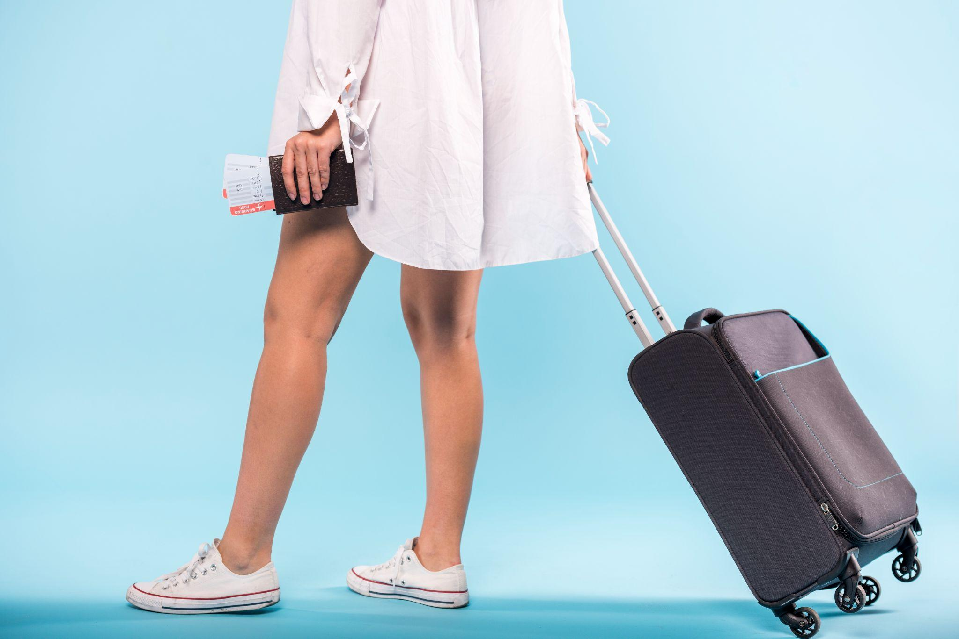
BOARDING PASS
Proposal of Machine Learning Model
NOTE:
Supervised Learning- Logistic Regression- binary result Delayed/Not delayed
What variables will be used for the machine learning model?
y= "Dep_Del15"
X= other columns (Carrier and Airport columns need to be converted to numerical data)

Slide 7
Proposal of Machine Learning Model
NOTE:
1) Create a model with LogisticRegression().
2) Train the model with model.fit().
3) Make predictions with model.predict().
4) Validate the model with accuracy_score().

Slide 8
Tableau Dashboard
LINK:
BOARDING PASS
FLIGHT
B345
GATE
D8
SEAT
29E
https://public.tableau.com/views/Book1_TC/DelayOccurencesvsDistanceGroup?:language=en-GB&publish=yes&:display_count=n&:origin=viz_share_link

